Slide 1
PİR ENGINEERING & MACHINARY
ÇORUM / TURKEY 2017

Slide 2
PİR ENGINEERING & MACHINARY
In Brief
Established at 2006 by Nejat Kara
300,000 TL Capital
Located at Çorum / TURKİYE
15000 m2 , 1000 m2 closed facilties
Machinary ,Steel Works, Pressurized Vessels, Engineering Services
HVAC, Otomation, Medical Machinary

Slide 3
PİR ENGINEERING & MACHINARY
In Brief
Established at 2006 by Nejat Kara
300,000 TL Capital
Located at Çorum / TURKİYE
15000 m2 , 1000 m2 closed facilties
Machinary ,Steel Works, Pressurized Vessels, Engineering Services
HVAC, Otomation, Medical Machinary
35 colleauges

Slide 4
PİR ENGINEERING & MACHINARY
Machine Park
3 Lathe
1 Planing machine
2 Milling Machine
1 Borwerk
2 Coulumn Boom Rotating System
3 Plazma Cutting
Welding Machines and others

Slide 5
PİR ENGINEERING & MACHINARY
Main Products
Hydro Works:
Pressureized Vessels
Container Vessels
Welding Robots
Rotating Melting Furnace
Steam, Hot Water, Hot Oil boilers

Slide 6
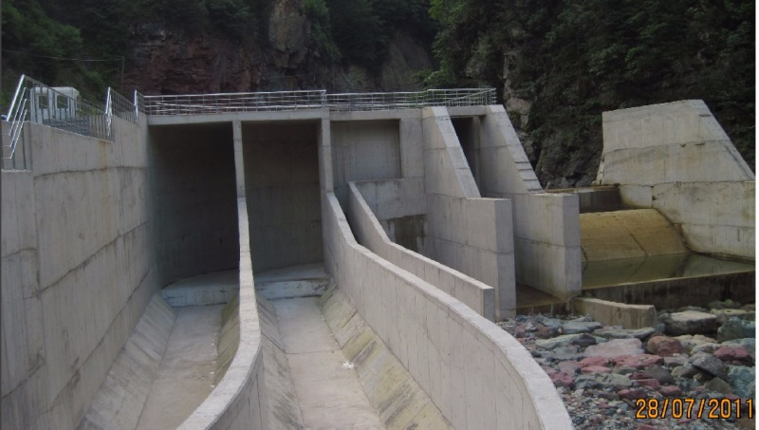
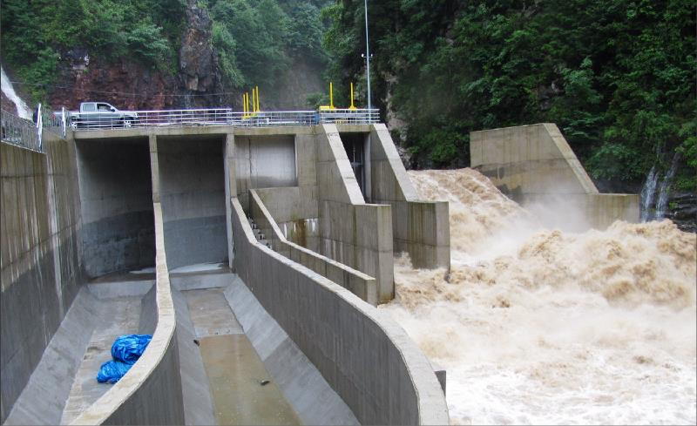
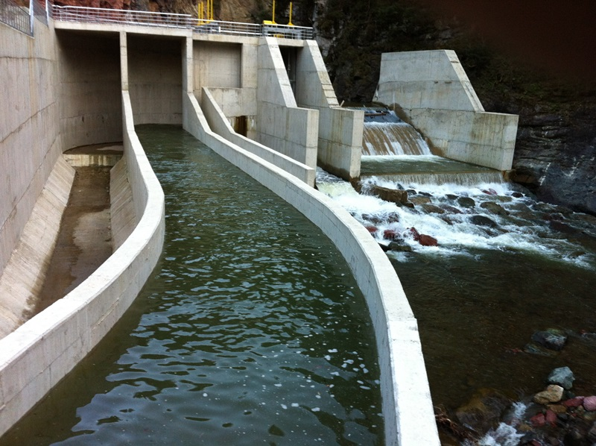
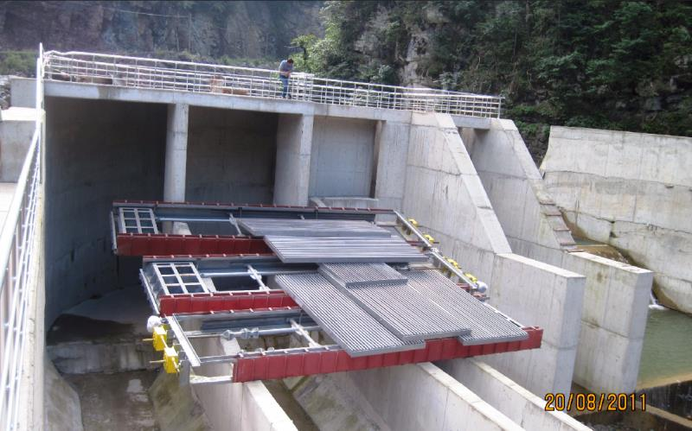
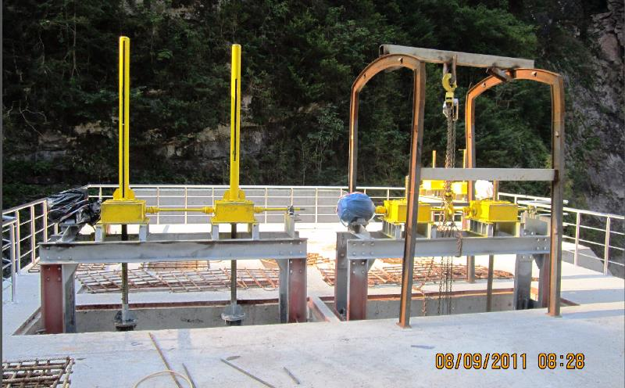
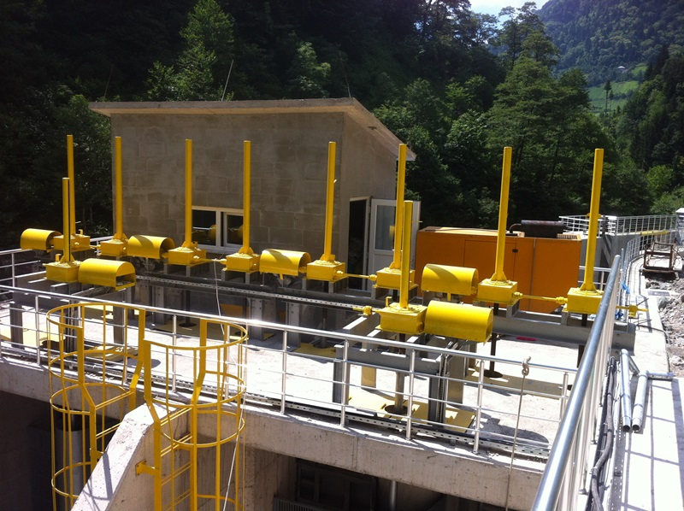
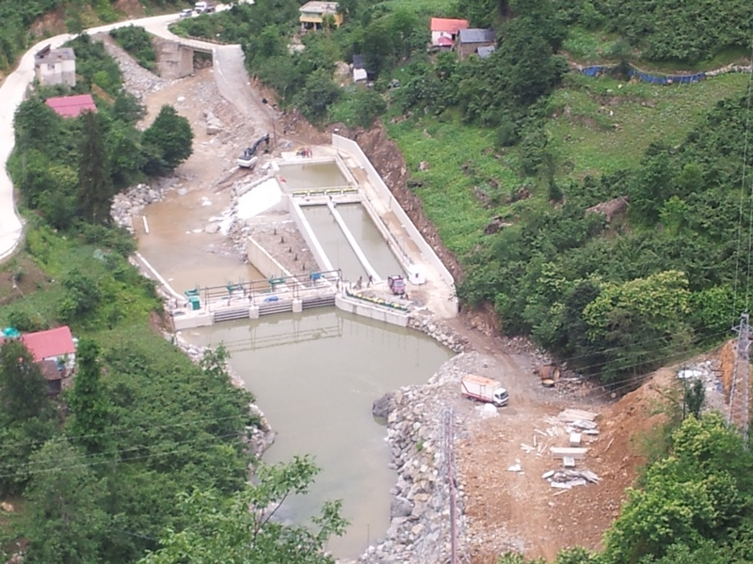
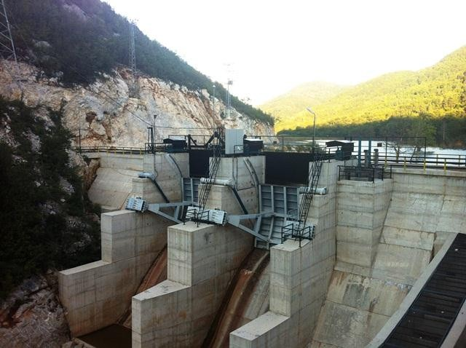
PİR ENGINEERING & MACHINARY

Slide 7
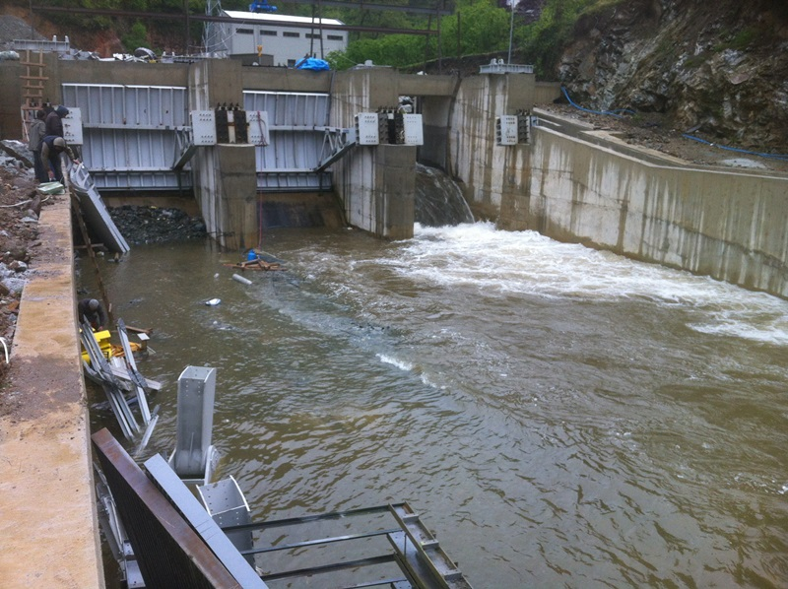
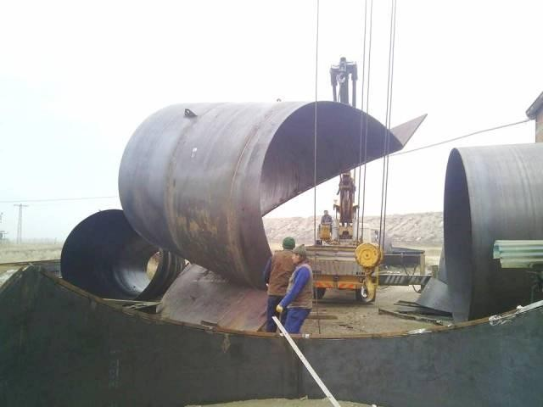
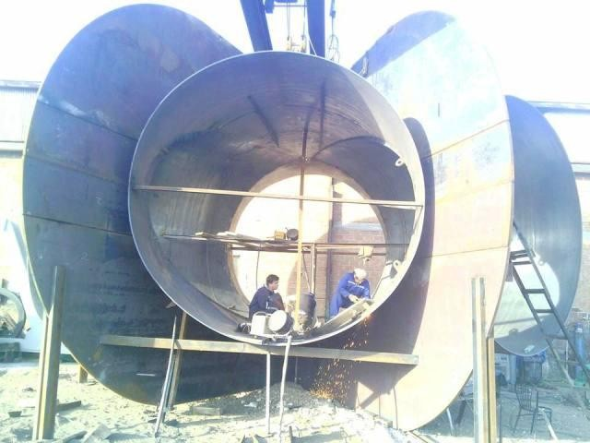
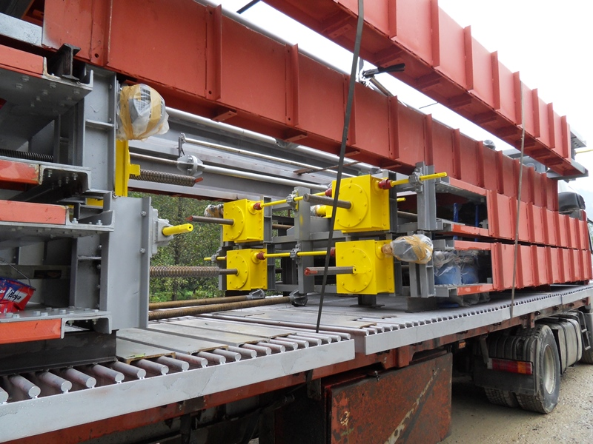
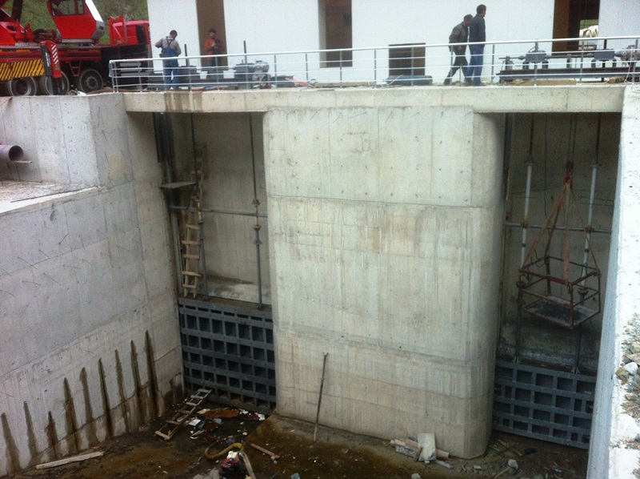
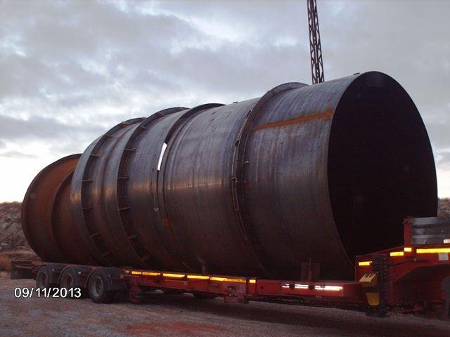
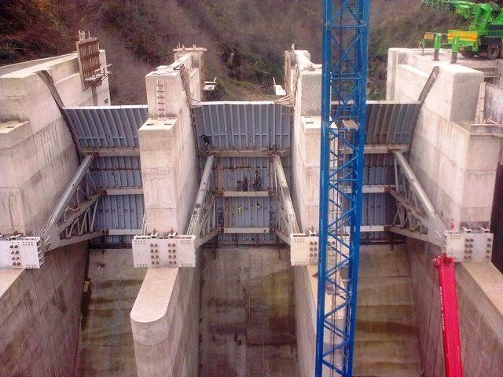
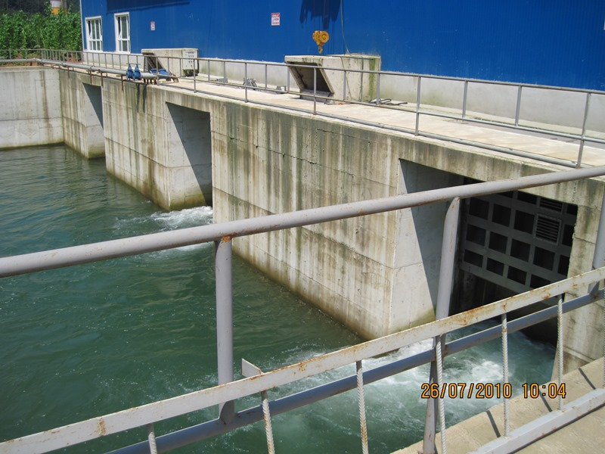
PİR ENGINEERING & MACHINARY

Slide 8
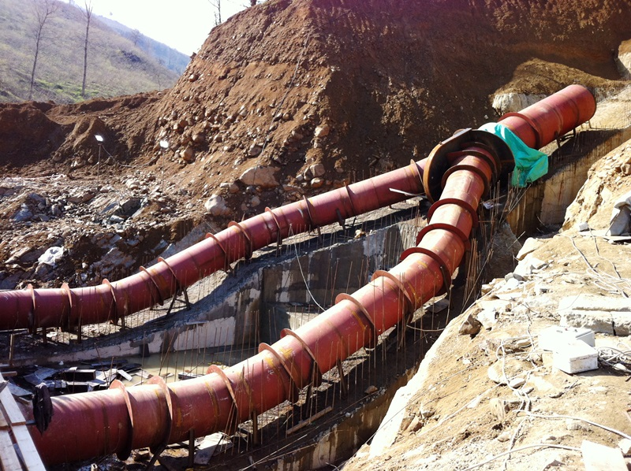
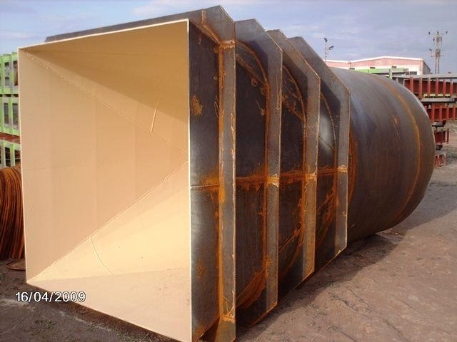
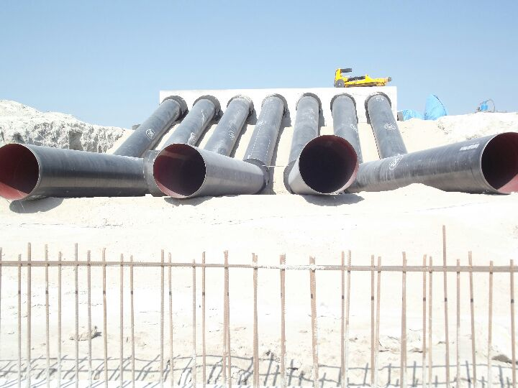
PİR ENGINEERING & MACHINARY

Slide 9
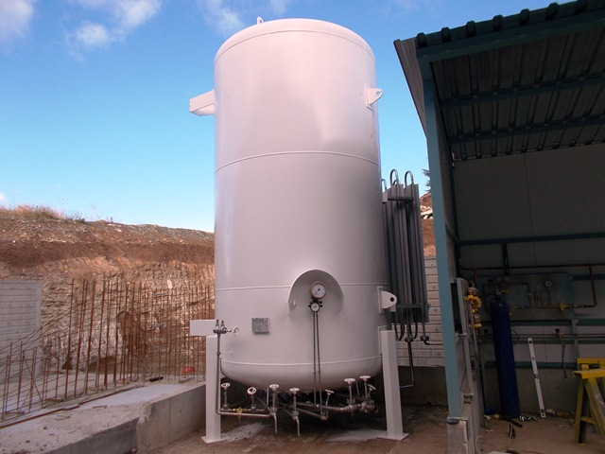
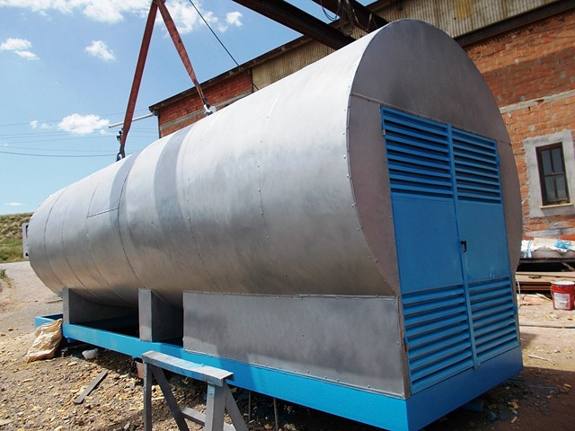
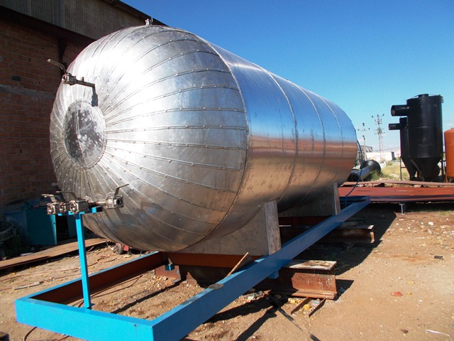
PİR ENGINEERING & MACHINARY
CO2
NG
LO2

Slide 10
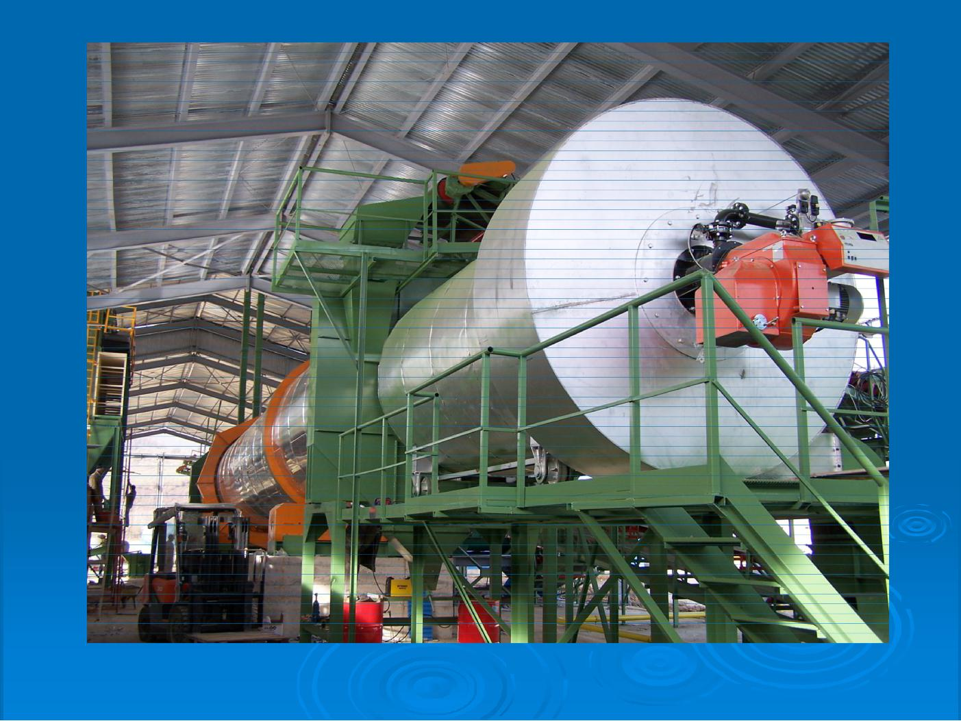
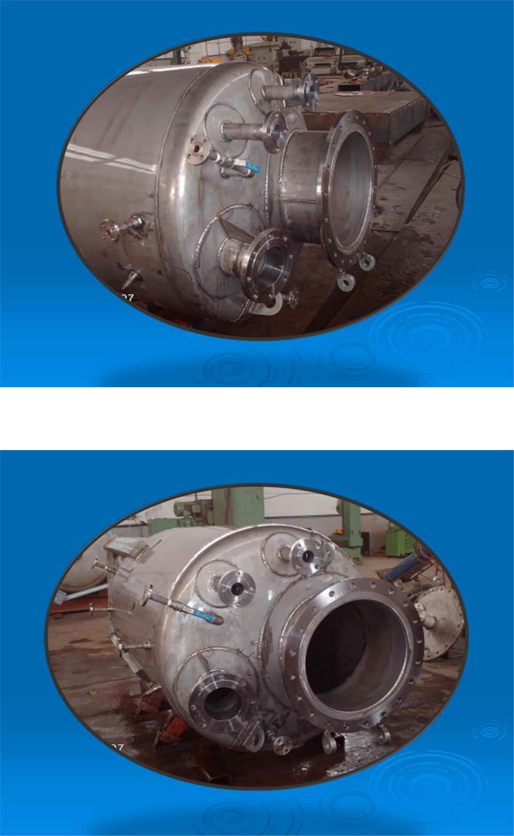
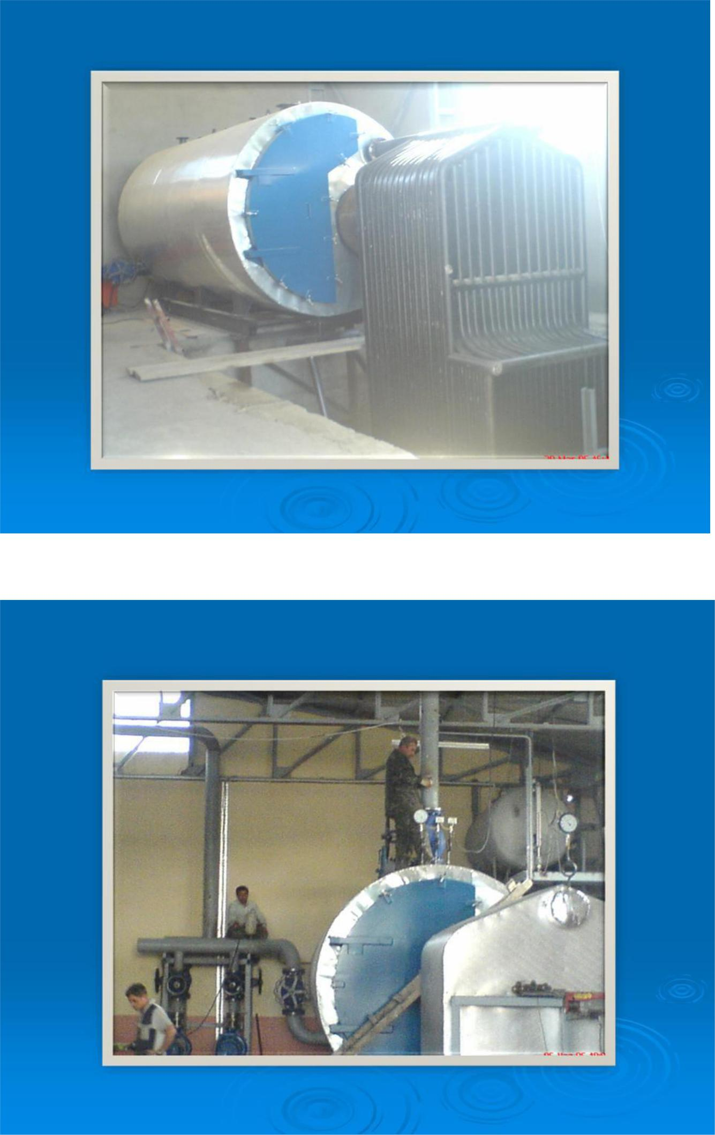
PİR ENGINEERING & MACHINARY

Slide 11
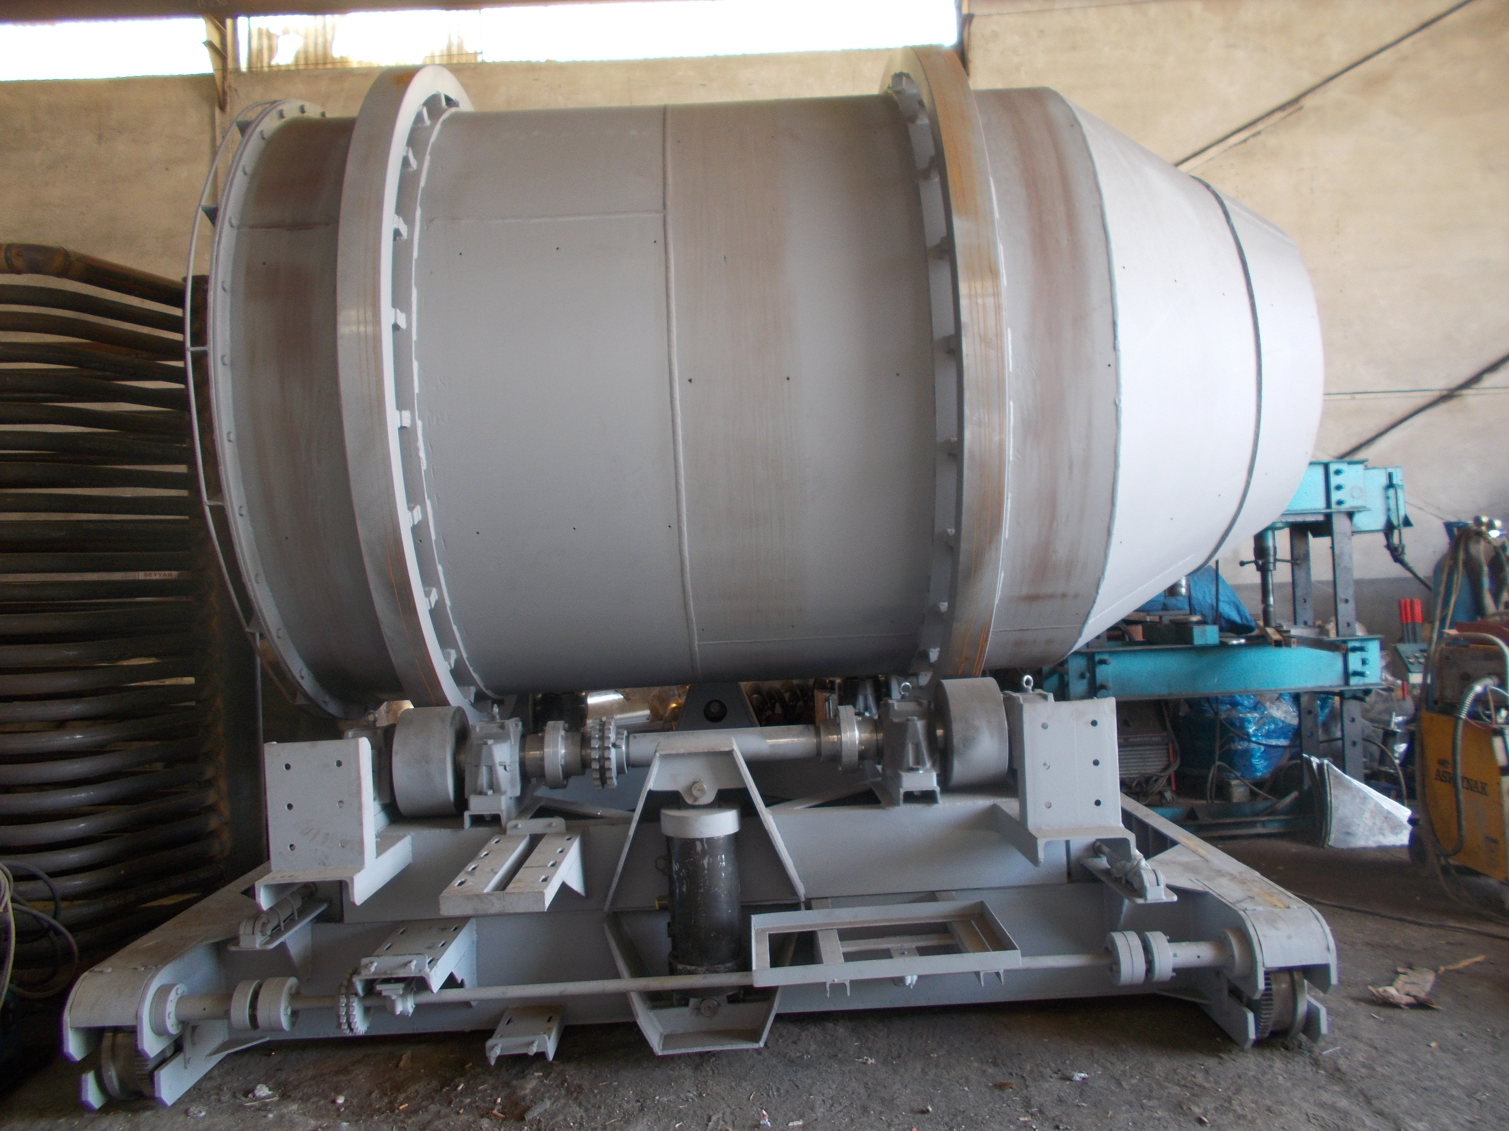
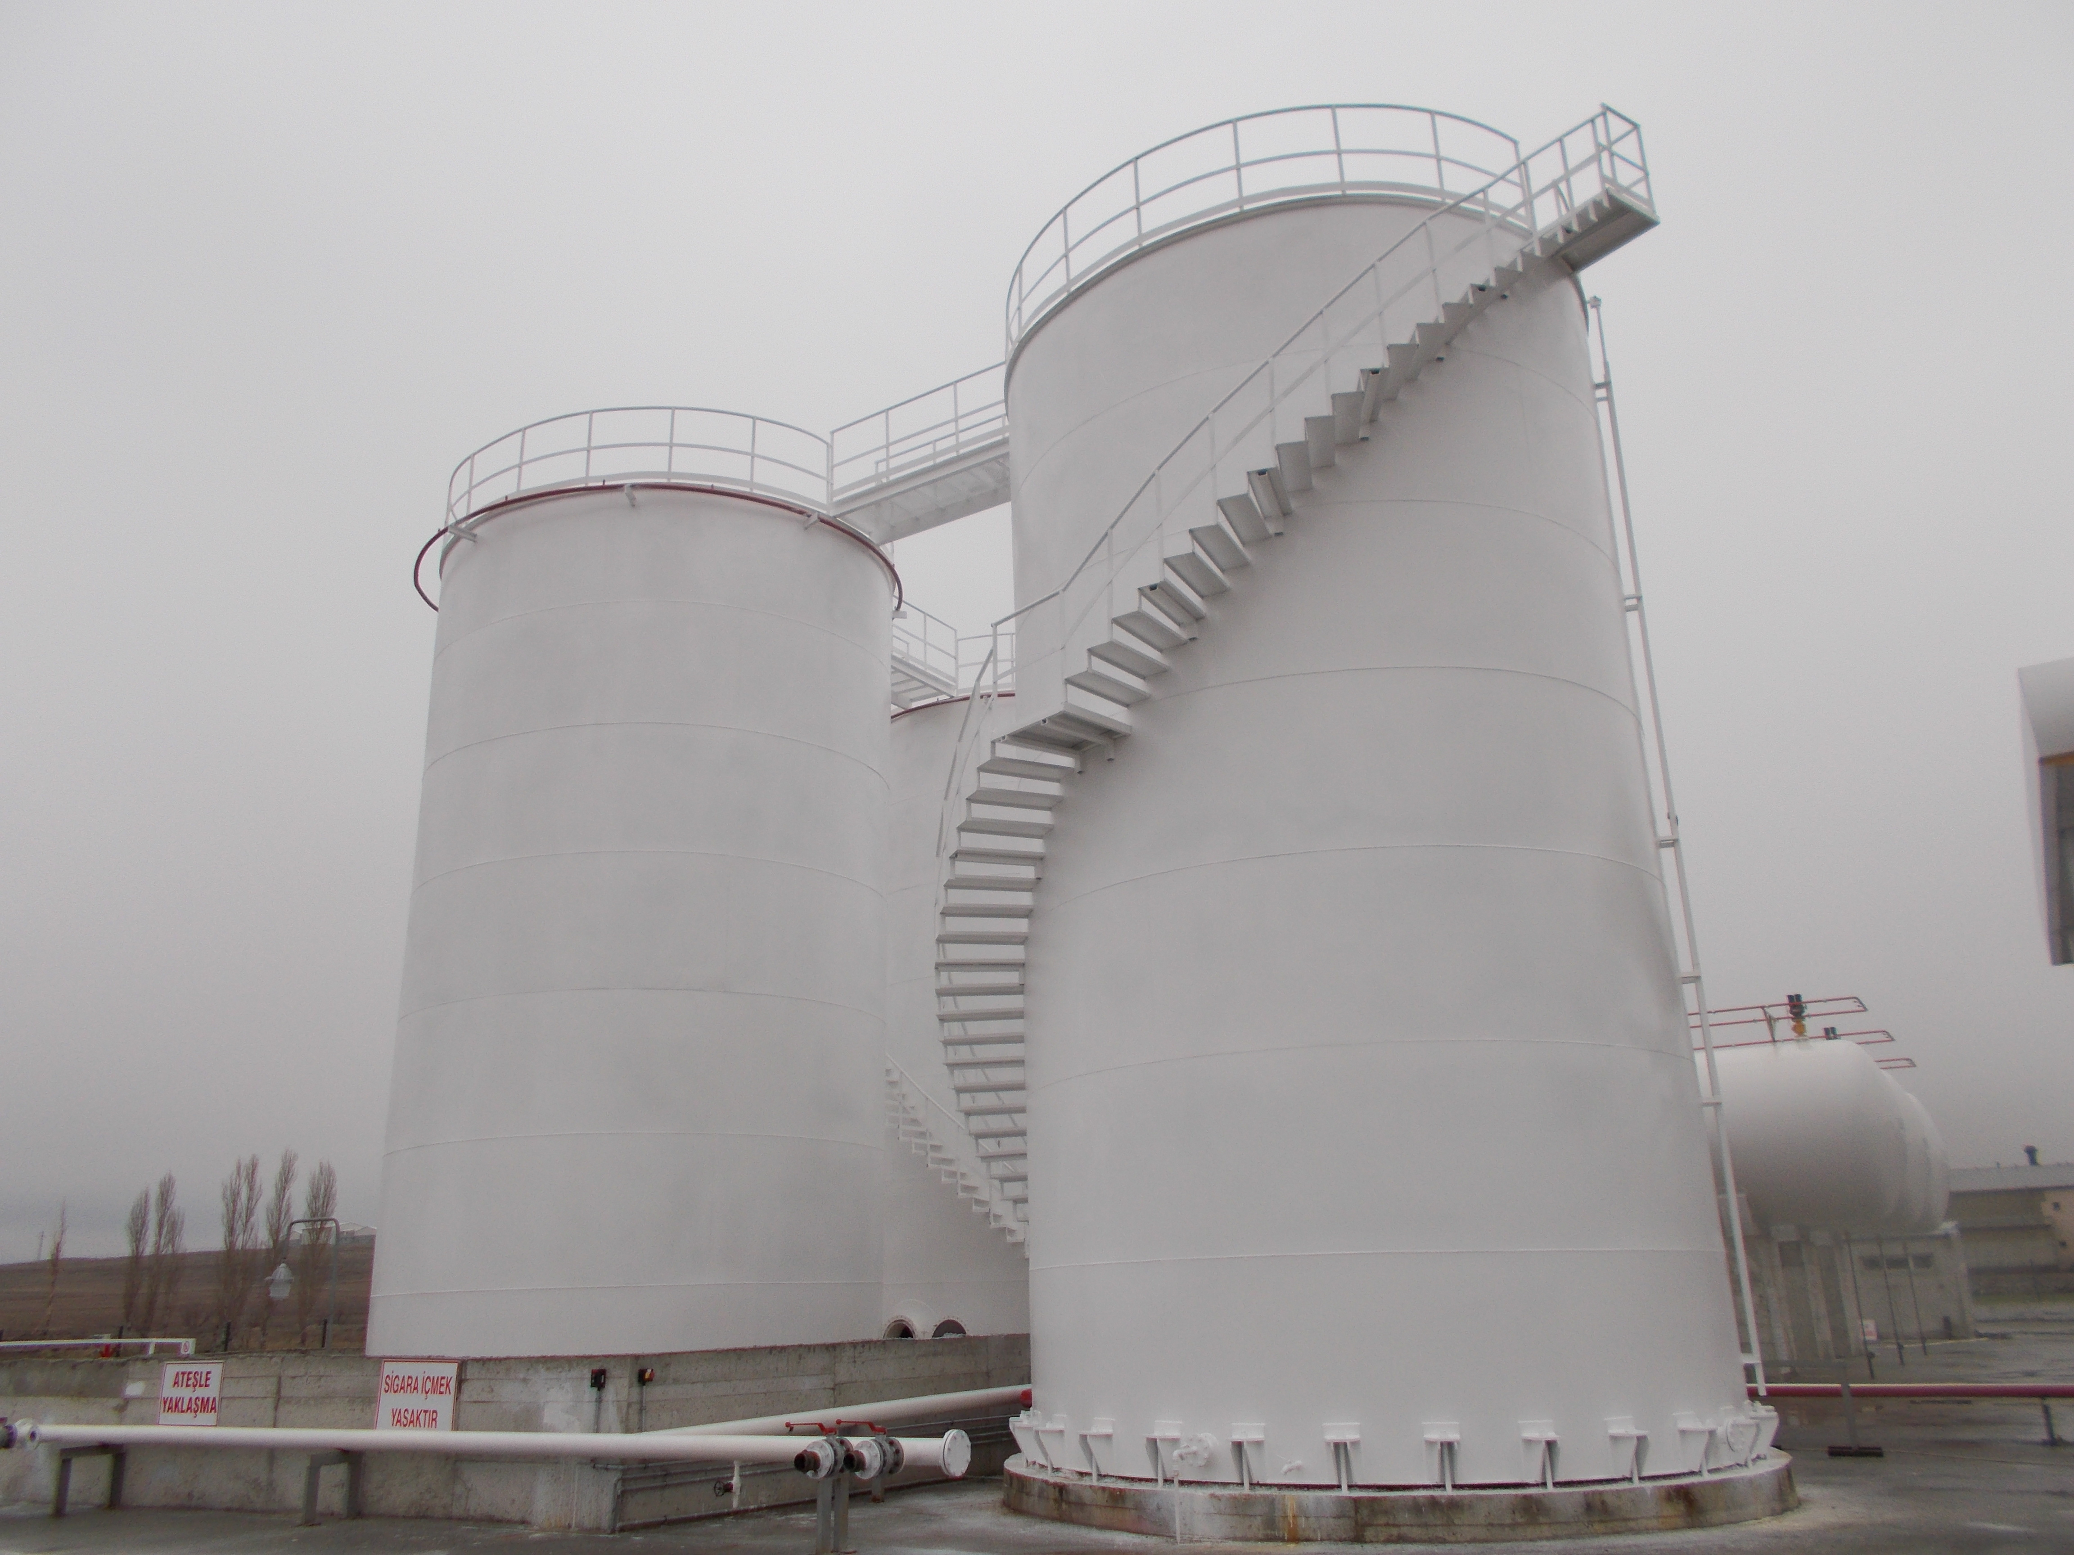
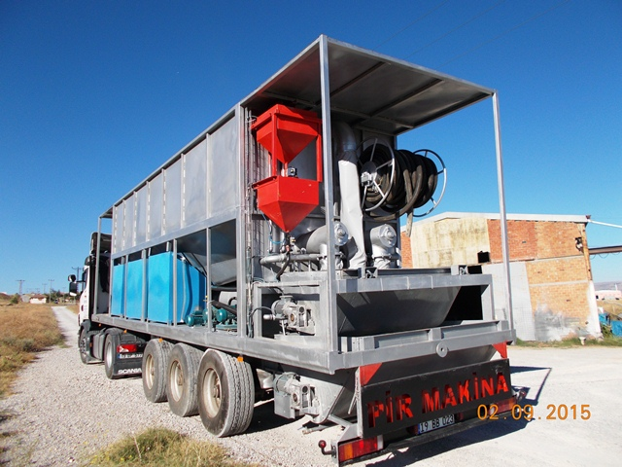
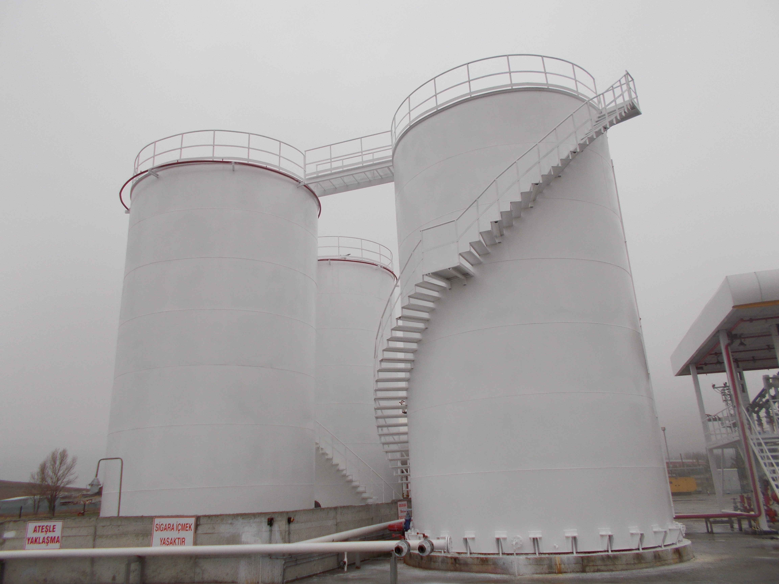
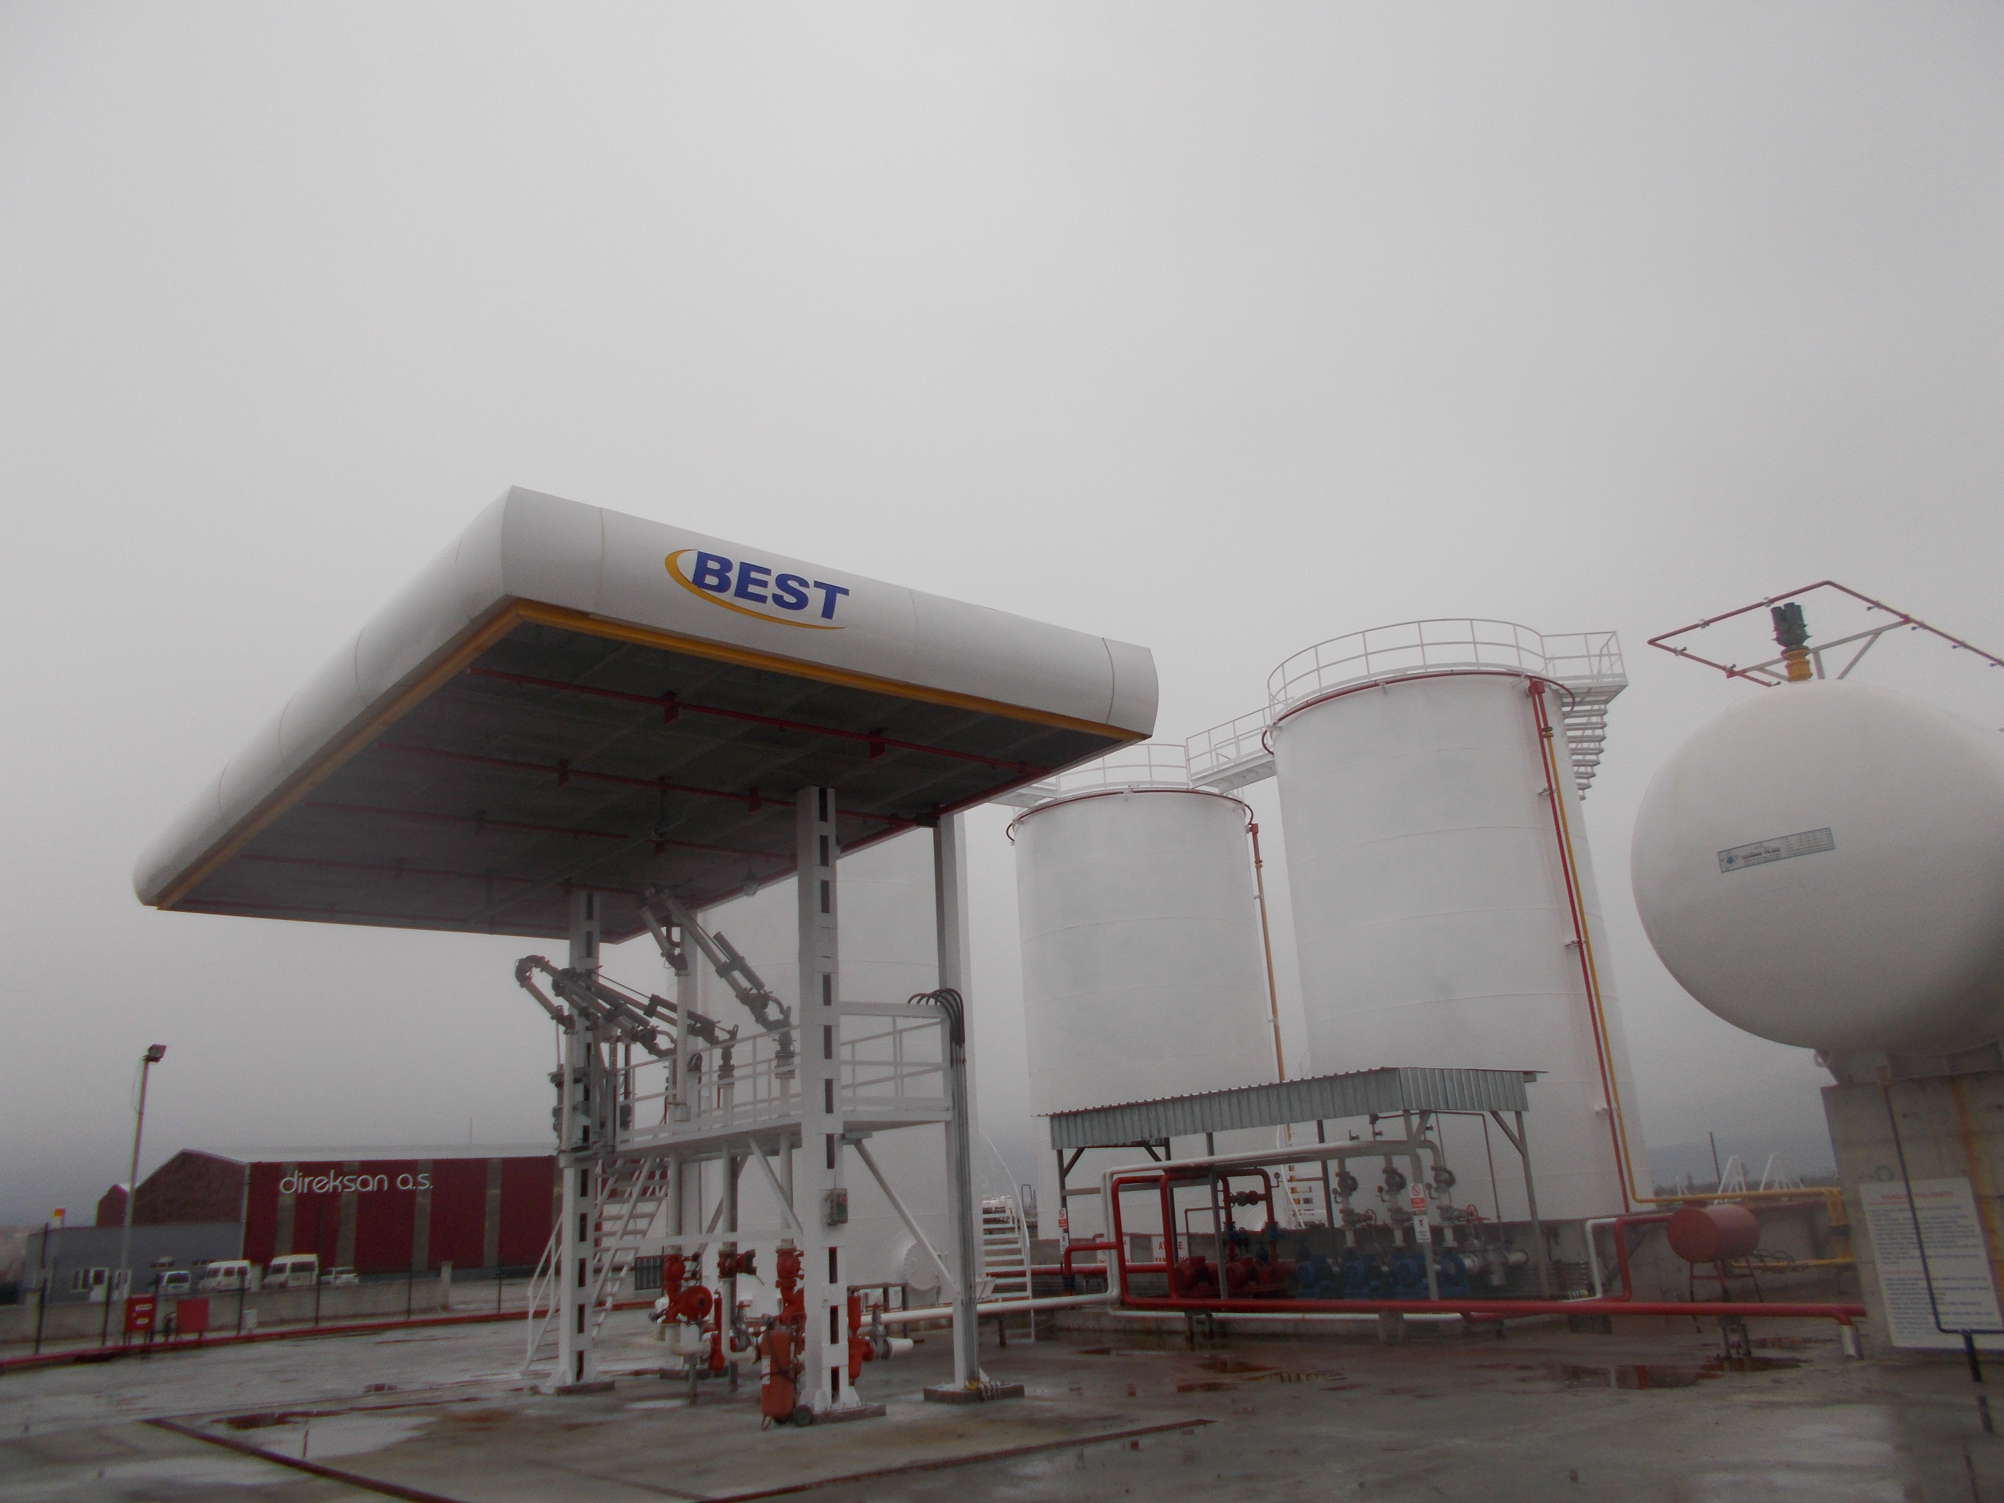
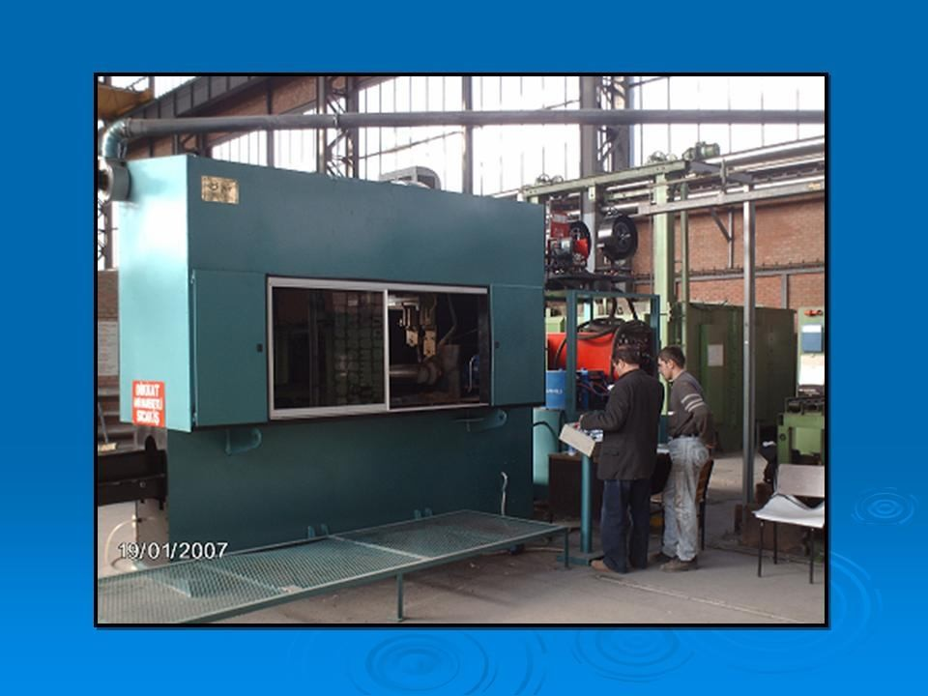
PİR ENGINEERING & MACHINARY

